Slide 1


Medical Inventory
Optimisation

Slide 2
Contents
Business Objective
Business Constraints
Project Architecture - Data Flow Diagram
Data Collection
Exploratory Data Analysis
Data Visualization
Notes:
Change

Slide 3
Business Problem
Bounce rate is increasing significantly leading to patient dissatisfaction

Slide 4
Project Overview and Scope
Project Overview
The Medical Inventory Optimization project aims to reduce the bounce rate by ensuring the availability of essential medical supplies, thereby improving patient satisfaction and minimizing inventory costs. By implementing an advanced inventory management system with real-time tracking, predictive analytics, and efficient supplier management, the project targets a 30% reduction in bounce rates and an increase in revenue by 20 lakhs INR.
Project Scope
1. Initial Assessment: Evaluate current inventory practices.
2. System Design: Create an optimized inventory management system.
3. Phased Implementation: Roll out the system in stages to ensure smooth transition.
4. Continuous Monitoring: Regularly check and adjust the system for improvements.
5. Staff Training: Provide comprehensive training for staff on the new system.
The project focus on cost-effective and reliable inventory practices to support better patient care. It will integrate new technologies and methodologies to enhance overall efficiency.

Slide 5
Data Dictionary
Column Name | Data Type | Description
Typeofsales | String | The type of sale (e.g., Sale).
Patient_ID | String | Unique identifier for each patient.
Specialisation | String | Specialization category of the treatment.
Dept | String | Department where the sale was made.
Dateofbill | DateTime | Date when the bill was issued.
Quantity | Integer | Number of units sold.
ReturnQuantity | Integer | Number of units returned.
Final_Cost | Float | Final cost of the sold items.
Final_Sales | Float | Final sales price of the items.
RtnMRP | Float | Return MRP (Maximum Retail Price).
Formulation | String | The formulation of the drug (e.g., Form1, Form2).
DrugName | String | Name of the drug sold.
SubCat | String | Sub-category of the drug (e.g., SYRUP & SUSPENSION, INJECTIONS).
SubCat1 | String | Additional sub-category information (e.g., VITAMINS & MINERALS, ANTI-INFECTIVES).
Year | Integer | Year extracted from the Dateofbill. (Created during preprocessing).
Month | Integer | Month extracted from the Dateofbill. (Created during preprocessing).

Slide 6
Exploratory Data Analysis [EDA]
Statistical Insights
Business Insights
Descriptive Statistics
Sales Trends
Correlation Analysis
Regression Analysis
Residual Analysis
Sales Performance
Inventory Optimization
Top-Selling Drugs
Customer Behaviour
Revenue Insights
Notes:
EDA is used for seeing what the data can tell us before the modeling task.
Change

Slide 7
Data Preprocessing
Handling Missing Values : Check for and handle any missing values in the dataset.
Data Type Conversion : Convert columns to appropriate data types, such as converting Date of bill to a datetime format.
Removing Duplicates : Identify and remove any duplicate rows.
Handling Outliers : Detect and address any outliers in numerical columns.
Standardizing Categorical Values : Ensure that categorical columns like Specialization, Dept, Formulation, Drug Name, Sub Cat, and SubCat1 have consistent and standardized values.
Creating New Features : Extract useful features from existing columns, such as extracting the year and month from the Date of bill.
Notes:
Keep observations

Slide 8
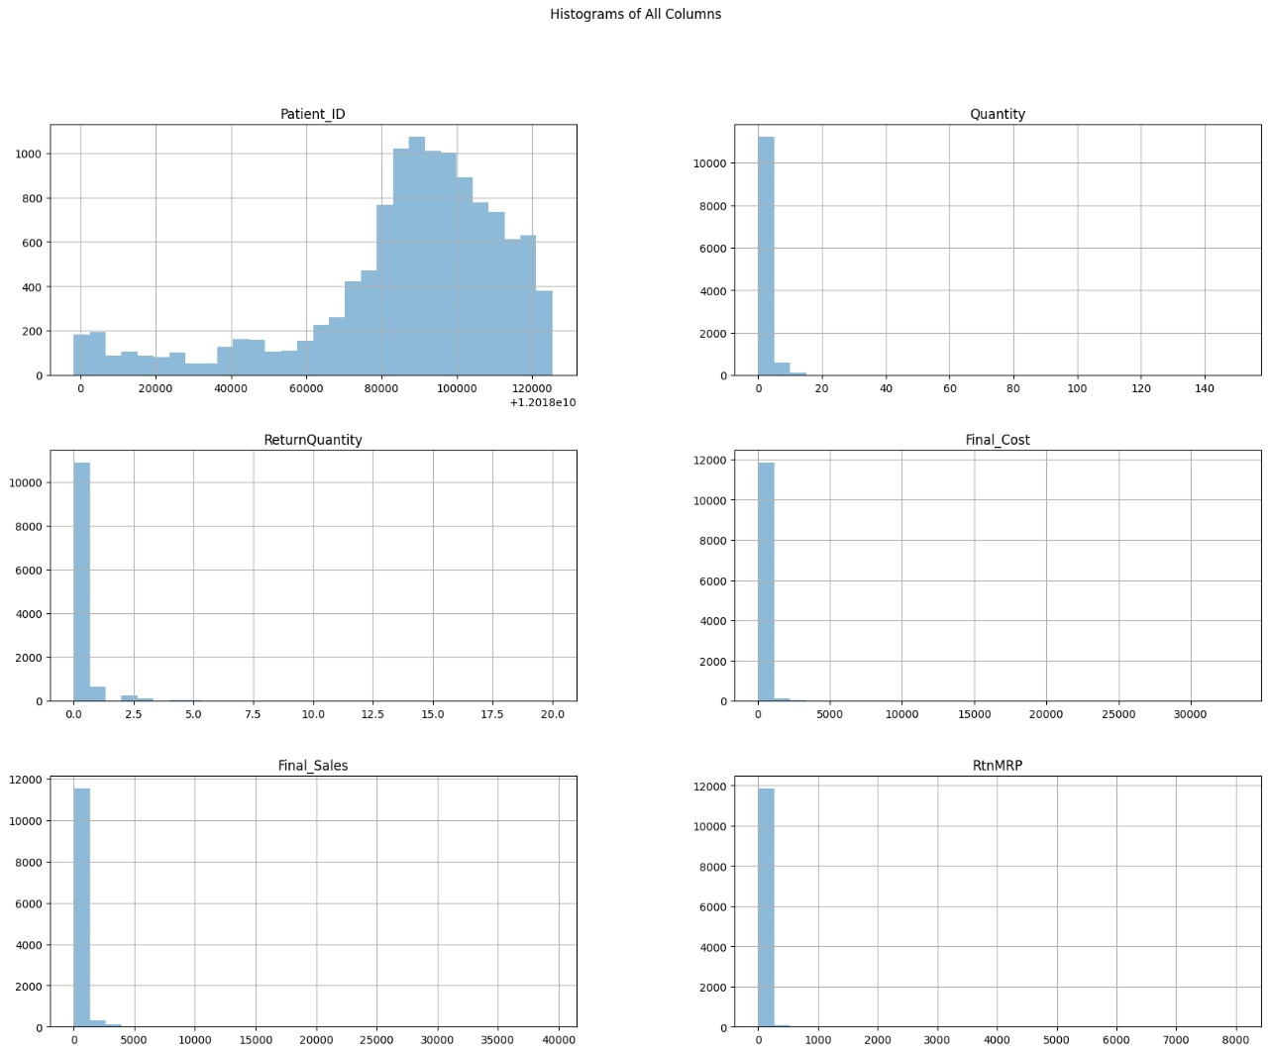
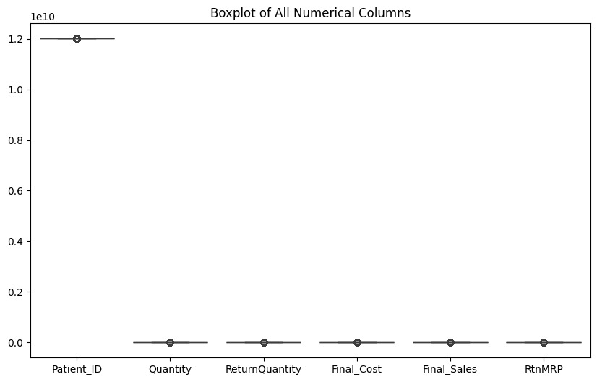
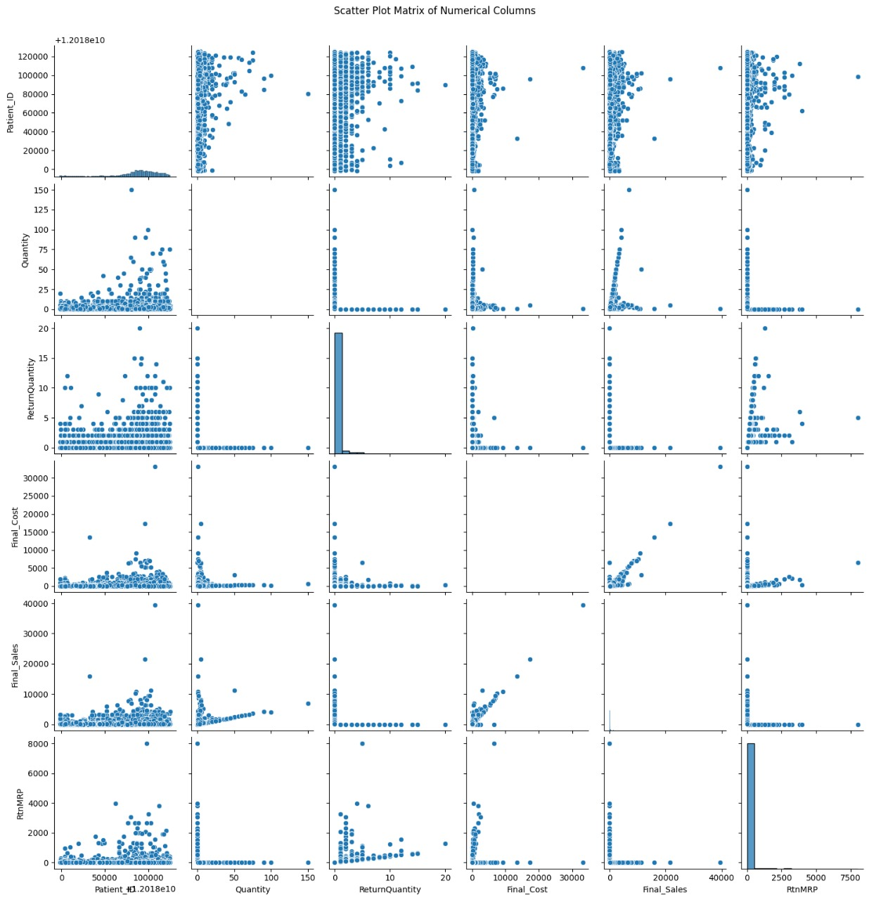
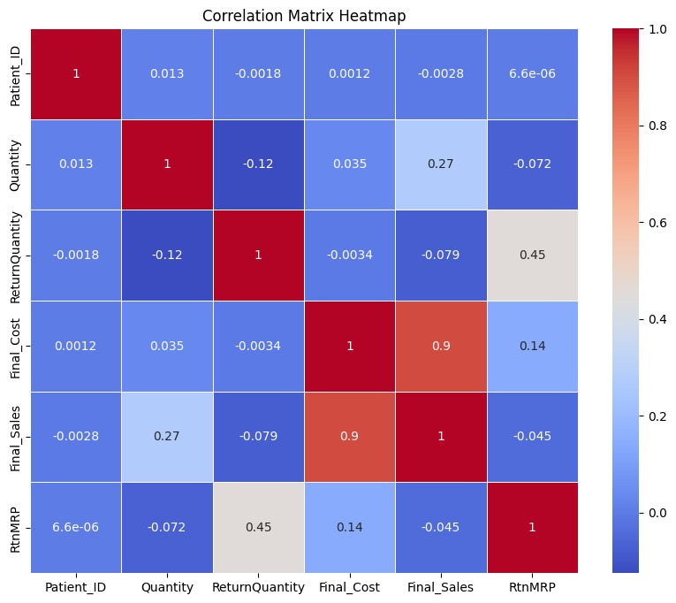
Data Visualization
Notes:
Add graphical

Slide 9


